Slide 1
Lecture 18 – Designing a processor
2018.02.19
Details are not the details.
They make the design.
– Charles Eames

Slide 2
Assignments
Today’s material is from chapter 6
HW05 due Thursday
Lab 06 due this week

Slide 3
Lectures 18 – Designing a processor
2018.02.19
King: Young Lady, look along the road and tell me if you can see either of my messengers.
Alice: I see nobody on the road.
King: I only wish I had such eyes. To see Nobody, at such a distance, too! It's enough for me to see real people by this light.
from Through the Looking-Glass, and What Alice Found There
by Lewis Carroll (Charles Lutwidge Dodgson), 1871.

Slide 4
About the details of seeing Nobody in CS
Running a program is a complicated business
Abstraction hides detail and helps understand a chosen level of the computational platform
Example: a typical C program abstracts (hides) the majority of its code using the #include mechanism
To know program function and limitations also requires knowing the library functions called
Abstraction, yes; but details always matter
Pay attention to hidden information about bus size, control signals, and data type conversion in Fig. 6.9
Be able to see Nobody, be able to see hidden detail

Slide 5
Build processor control – decode instr.
Decoding an instruction means to
Interpret all fields of instruction format and
Control the data path – generate logic signals to tell the data path circuit what to do
A well-chosen instruction format makes decoding cheaper and faster (simpler circuit)
Very easy decoding for our textbook example, just partition the 32 wires carrying the instruction bit string

Slide 6
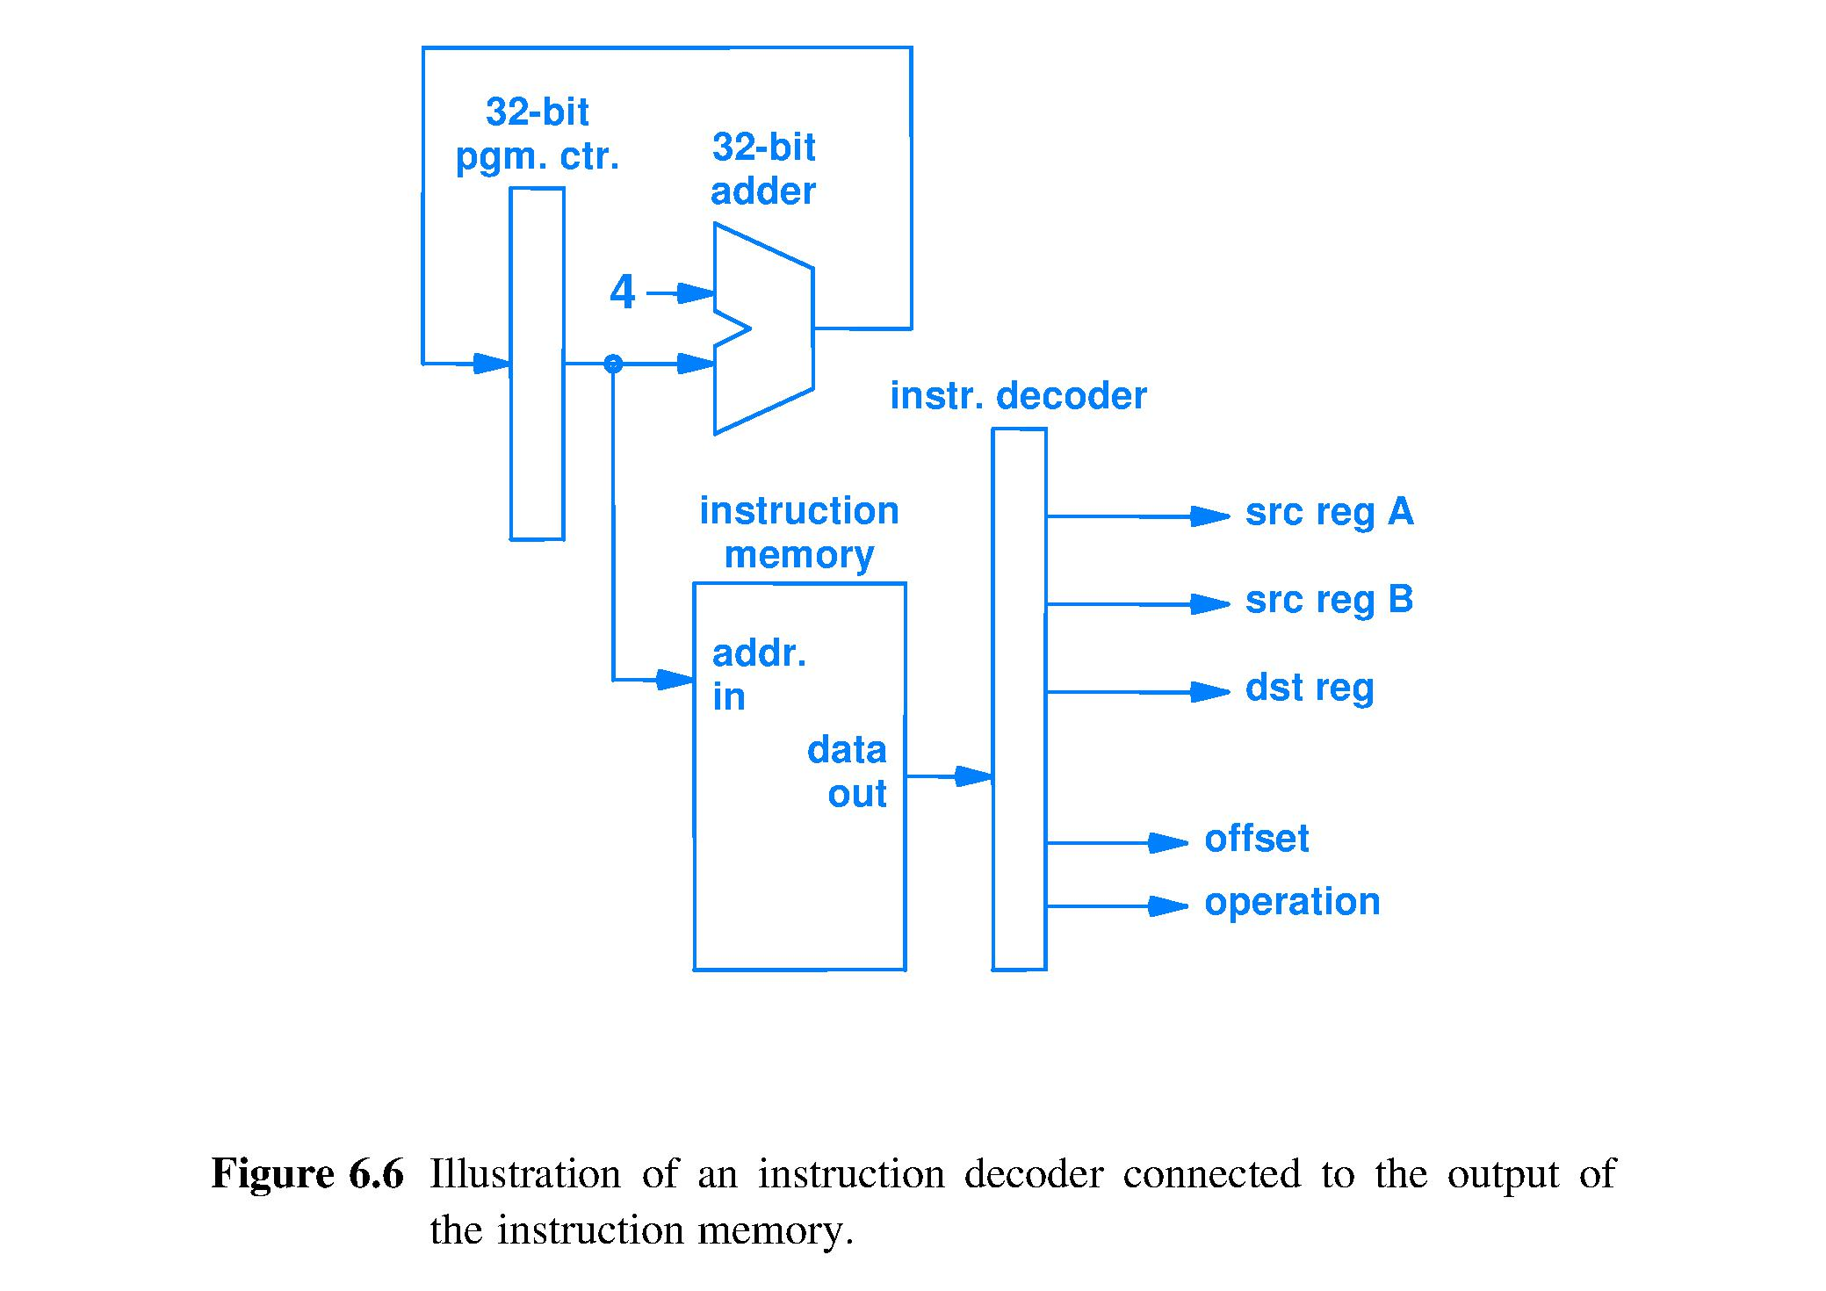
Decode for the example processor
32-bit string from Instruction Memory Data Out wires is decoded by grouping wires according to the instruction format fields.
Most instruction sets are more complex to decode.
Wire group functions are:
• Pointing to a memory location (3 instances, 4 bits each) • Value delivery (15 bits) • Selection of operation within arithmetic/logic unit (ALU) circuit (another pointer, 5 bits)
Constant
Pointer
32
/
32
/
32
/
32
/
4
/
Pointer
Instruction
4
/
Pointer
Address, or pointer
Pointer, or address
4
/
Pointer
32
/
Value, constant
15
/
/
5
Control, selects operation (points)

Slide 7
Time to: 2) Locate and read operands
Instr. memory provides one instruction per fetch
Execution of this ISA needs up to three memory accesses: 2 operands (reads) and 1 result (write)
For speed of execution, want execution memory to support three, independent simultaneous accesses; but it need not be a large number of locations
Today’s technology’s solution is the register unit, a.k.a. the register file
A small collection of registers, each register sized to hold the bit string of a default-size number or a default-size memory address

Slide 8
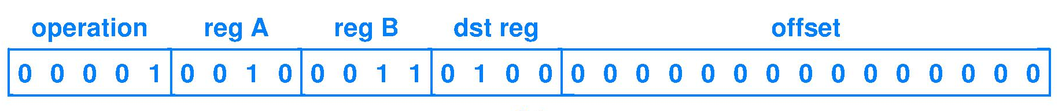
Time to: 2) Locate and read operands
Which fields are operands?
Operands in the instruction format are
reg A, reg B, and offset which are, respectively
pointer, pointer, and immediate value
What to do with pointer bit strings?
Send the 2 pointers to address inputs of register unit (file)
Register file outputs copies of the bit strings that are g being stored in the two registers pointed to
Immediate value bit string is sent directly to the ALU

Slide 9
Register Unit (register file) ckt. details
Contains sixteen 32-bit registers
Inputs: 45 wires, as follows
[12 bits] Three 4-bit addresses because one instr. may access reg_A, reg_B, and dst_reg
[32 bits] Result value to be written into dst_reg
[1 bit] Not every instruction uses dst_reg, so a Write_Enable control signal input for the Register File (abstracted out, not shown in textbook figures) is necessary to enable/disable storing (writing) a result
Outputs: 64 wires
Copies of the 32-bit contents of any 2 of 16 registers, including ability to duplicate contents of one register to both outputs

Slide 10
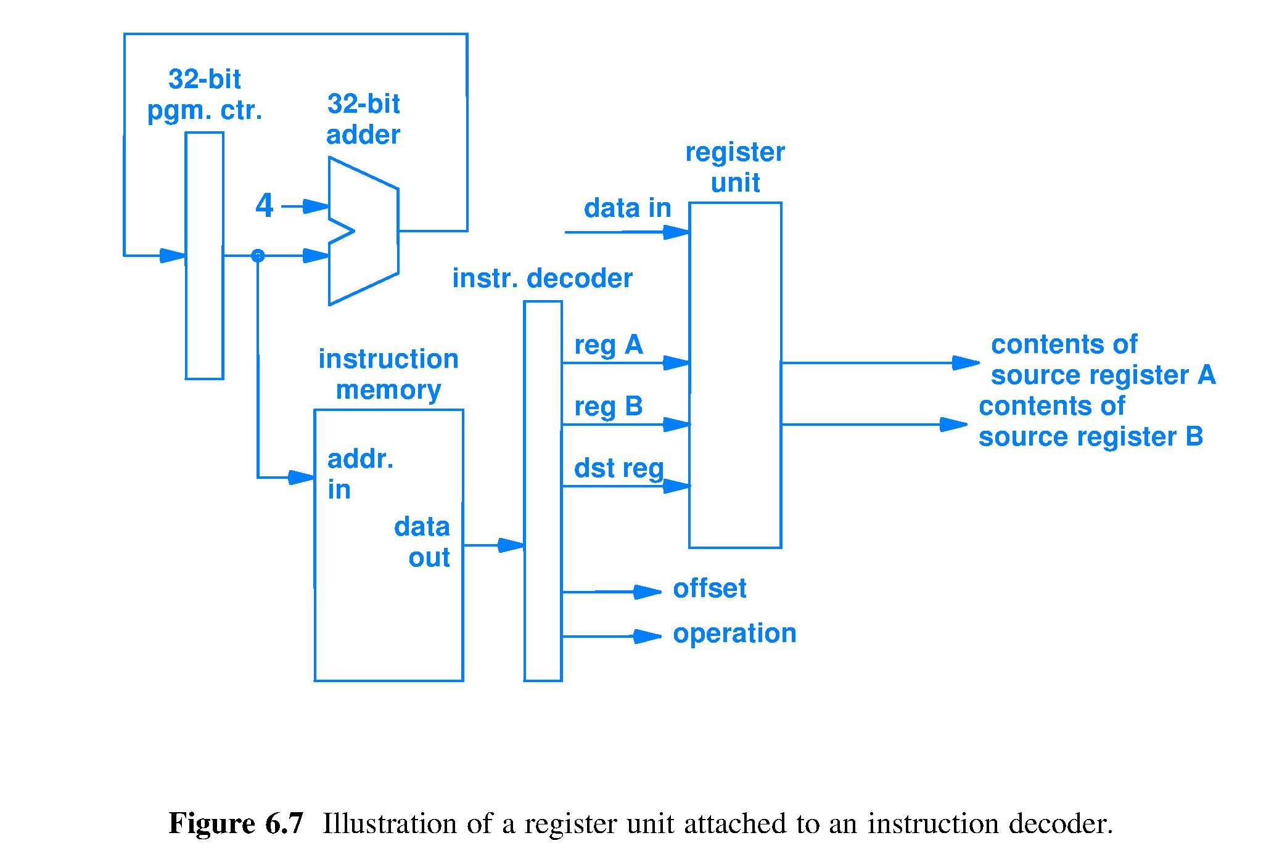
Read operands, completing Fetch
Copy of
15-bit value direct to ALU
5 bits of control signals (pointer) direct to ALU
Notes:
Use thought question #1, #2, #3, and #4 here.

Slide 11
Time to: 3) Execute instruction
Execution circuit (ALU) supports all instructions
Instr Definition add contents[dst_reg]← cont[reg_A]+c[reg_B] load c[dst_reg]←Data_Memory[offset +c[reg_A]] store Data_Memory[offset + reg_A] ← reg_B jump Fetch at Instr_Memory[offset + reg_A]
What does each instruction ask of the ALU?
add: add values sourced from reg_A and reg_B
load: add offset and contents of reg_A
store: add offset and contents of reg_A
jump: add offset and contents of reg_A
ALU must perform integer add for all 4 ISA instr.

Slide 12
Design ALU input (operands) circuit
Textbook author’s design choice is to implement add Offset and value sourced from Reg ? as Offset + reg_A
Could have chosen Offset + reg_B

Slide 13
Design ALU input (operands) circuit
Design question #1: How should we build the circuit so that ADD instr. sends reg_A and reg_B to the ALU, while LOAD/STORE/JUMP send reg_A and Offset to ALU?
Answer: Use a MUX to select Offset or reg B as needed
Design question #2: How do we match the 15-bit offset representation to the 32-bit ALU?
Answer: Increase the 15-bit size of the 2’s complement Offset to 32 bits using sign extension

Slide 14
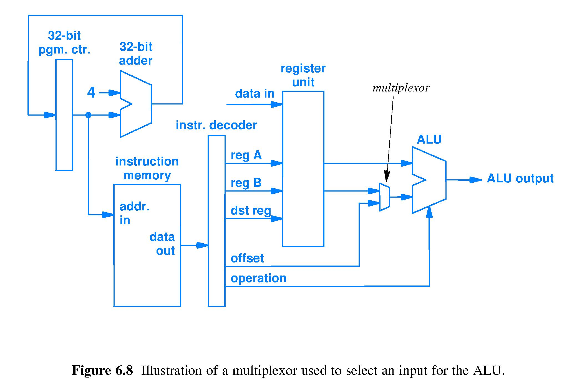
Arithmetic/Logic Unit (ALU) in action
Selected operand
reg A 32-bit value
reg B 32-bits
Opcode bits to control ALU
Sign extend
32-bit sign extended offset value in 2’s comp
15 bit offset in 2’s comp
Mux circuit chooses 1 of 2¹ inputs to connect to ALU. Mux must receive a 1-bit signal controlling which 1 of 2¹ inputs is selected. Mux control input wire (1-bit pointer to sign-extended offset or to reg B) is abstracted out of diagram.

Slide 15
ALU has produced a result; what next?

Slide 16
Time to: 4) Write result into specified location
What are the results and where do they go?
ADD: ALU output is the result, deliver to dst_reg
JUMP: ALU output is next_instr_ptr, deliver to pgm. ctr. (current_instr_ptr register)
LOAD: ALU output is pointer that must be sent to data memory, which then produces copy of the location contents which, finally, must be written into dst_reg
STORE: ALU output is pointer that must be sent to data memory along with the value from reg_B to be written into the data memory location

Slide 17
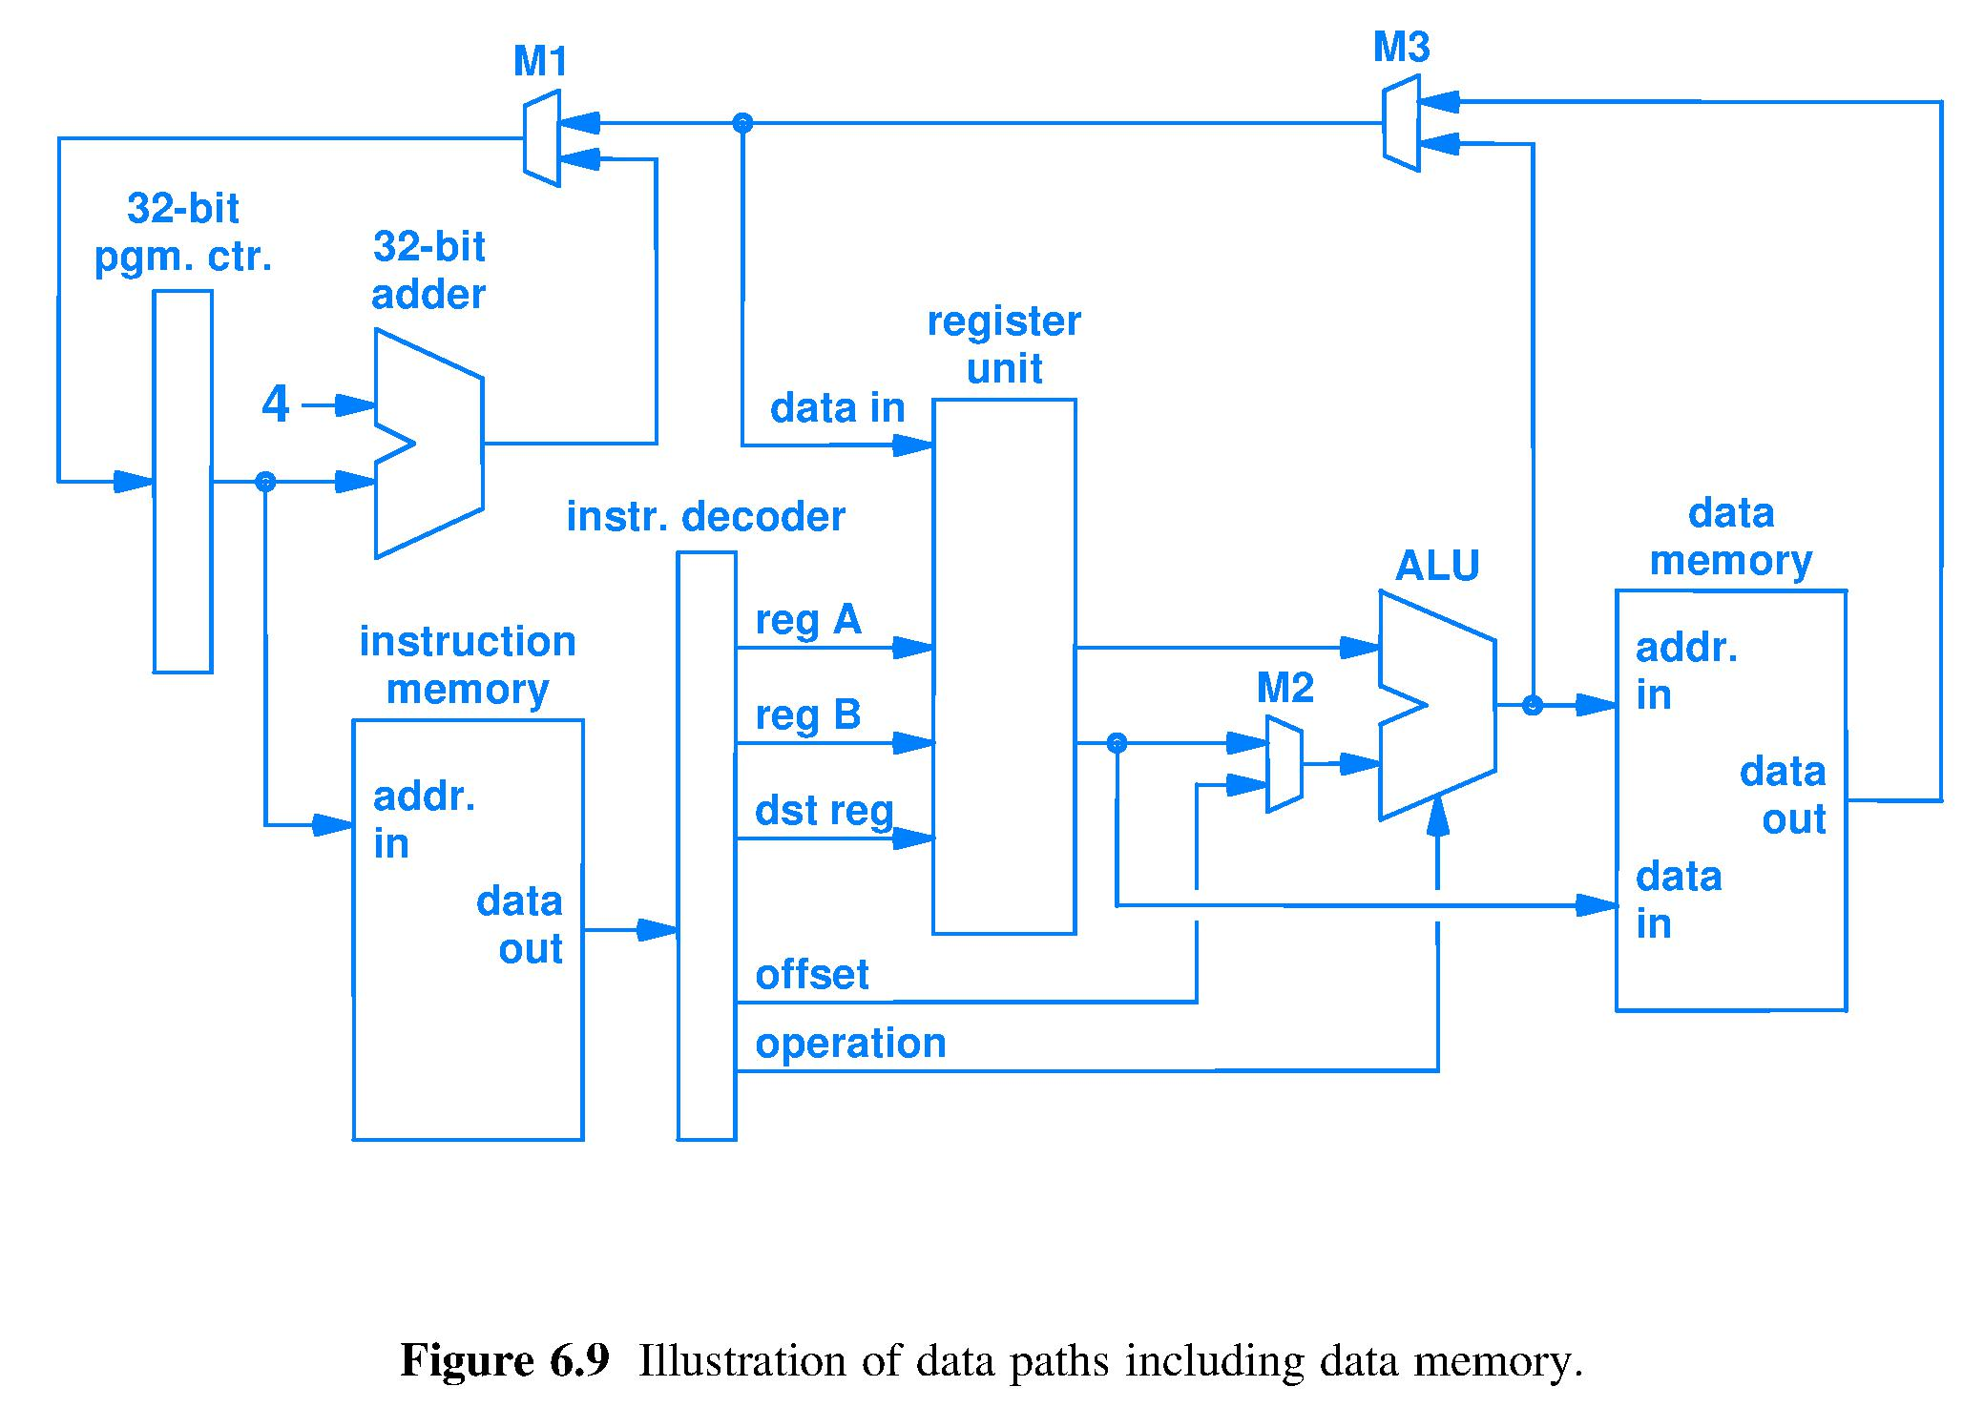
Put ADD result where it belongs
ADD result data path
ADD: ALU output is the result, deliver to dst_reg. Result has the meaning “integer” because it comes from the integer adder output. However, looking at the voltages on the data path (bus) wires is insufficient to determine whether the integer has unsigned or 2’s representation because the adder circuit works with both formats.

Slide 18
Put LOAD result where it belongs
LOAD result data path
LOAD: ALU output is pointer sent to data memory, which then produces a copy of the location contents which, finally, must be written into dst_reg; Result is a bit string from memory: no inherent meaning at this level of abstraction. Meaning is imposed at a higher level by the software.

Slide 19
Put STORE result where it belongs
STORE result data path
STORE: ALU output is pointer sent to data memory along with the value from reg B to be written into the data memory location. Result is a bit string from reg_B written in memory, where it has no inherent meaning.

Slide 20
Put JUMP result where it belongs
JUMP result data path
JUMP: ALU output is a computed Next_instruction_pointer, must deliver to Instruction_pointer_register. Result meaning is location of next instruction on the run-time execution path.

Slide 21
Result: Default_next_instruction_pointer
Default_next_instruction_pointer
Default_next_instruction_pointer is computed after every fetch because it is likely to be needed. Result meaning is location of sequentially_next instruction.

Slide 22
All result paths, overlapped
ADD result data path
JUMP result data path
LOAD result data path
STORE result data path
Input choices by Mux M3 and Mux M1 control where ADD, LOAD, and JUMP results are delivered (Mux control abstracted)

Slide 23
Figure 6.9 is fundamental
Learn the function of each wire and device, the number of bits anywhere, the data type of every bit string, and the operation of abstracted control circuitry and you will know the central processing unit (CPU) of a computer

Slide 24
Summary
A circuit that can fetch and execute instructions is programmable
The bits in machine code instructions control the operation of the data path; not all instruction format bit positions contain information for every instruction
Multiplexers route bits traveling on buses from hardware units to a hardware unit
Meaning of bits is set by the hardware unit (1) receiving the bits or (2) computing the bits

Slide 25
Lecture 19 – More speed using pipelining
2018.02.21
I feel the need – the need for speed!
– Lt. Pete “Maverick” Mitchell and Lt.(jg) Nick “Goose” Bradshaw
in the movie Top Gun

Slide 26
Assignment for today
Covering chapter 5.13 through 5.17 from the hardware perspective
Read chapter 7 and 8

Slide 27
Announcements
HW05 due Thursday
Lab 06 due this week

Slide 28
Look for steps within fetch-execute cycle
Observe signals as they propagate through the processor circuit.
Look for a sequence of simple actions that execute an instruction.

Slide 29
1) Fetch an instruction and compute the Default_Next_Instruction_Pointer
← Default_Next_ Instruction_Pointer
Current_Instruction_Pointer →
Fetched
instruction
Fetch done using Current_Instruction_Pointer, also known as (a.k.a.) the Program Counter

Slide 30
1) Fetch, 2) Decode instr., access operands, and sign extend offset
Sign extend
Decode, point to, and access registers and sign extend offset. All of this is performed by the circuit regardless of opcode.

Slide 31
1) Fetch, 2) Decode, 3) Execute instr.
Sign extend
ALU and M2 control inputs are functions of Opcode field bits

Slide 32
Fetch, Decode, Ex, 4) access Data Mem
Sign extend
Data Memory (DM) always receives Addr._In and Data_In bit strings. READ_Enable (RE) & WRITE_Enable (WE) DM controls are functions of Opcode. DM reads at Addr._In if RE = true, writes Reg_B_Value at Addr._IN if WE = true, and does nothing if RE = WE = false.

Slide 33
Fetch, Decode, Ex, Mem, 5) Write Back
Sign extend
Bit strings from all sources of results are routed by M3 and M1 to the appropriate destination register (32-bit pgm. ctr. is a register). M3 and M1 control signals are functions of the Opcode.

Slide 34
Clock rate and instruction rate
The pace of the processor Fetch-Execute cycle is set by a clock signal
Number of clock cycles necessary to Fetch and Execute an instruction and the clock cycle frequency depends on
Processor circuit design (not pipelined, pipelined)
Specific instruction to be executed
ALU circuit design (“better” circuit design has a smaller worst case propagation delay)
Speed of memory technology storing operand(s) and result (may be slower than processor circuit)

Slide 35
One-instruction-per-clock-cycle design
Clock
Circuitry put into action by current instruction bits
Long signal paths imply long propagation time, implies long wait for current instruction to complete fetch-execute, implies a long wait until the circuit can fetch the next instruction
The only clocked device,
the PC register
Sign extend

Slide 36
Processor design criteria
Designs should be evaluated against a set of criteria important for the given user, e.g.,
Software compatibility
Performance
Price
Power consumption
…
Which criteria are common to most users?
After primary concerns of software compatibility, users often care next most about performance
Much effort in computer architecture focused on performance and power consumption

Slide 37
Example: time to do laundry
Assume you have:
One washer (takes 30 minutes)
One drier (takes 40 minutes)
One “folder” (takes 20 minutes)
Takes 90 minutes to wash, dry, and fold 1 load of laundry.
How long does it take to do 4 loads?

Slide 38
One-load-at-a-time process (sequential)
6 PM
7
8
9
10
11
Midnight
Time
30
40
20
30
40
20
30
40
20
30
40
20
4 loads done sequentially takes 6 hours
Is there a faster way to process 4 loads?

Slide 39
Laundry pipelining
Overlap the loads – start each new load as soon as possible, given available resources
6 PM
7
8
9
10
11
Midnight
Time
30
40
40
40
40
20
4 loads in 3.5 hours

Slide 40
Pipelining terminology
6 PM
7
8
9
Latency is the time from start to finish to wash one load of clothes
Throughput is the rate at which loads are completed
Pipelining does not decrease latency of any single load
Pipelining increases throughput when there is a collection of loads
Ideal technique? No Darn good? Yes
Time
30
40
40
40
40
20
1 Thru
Latency

Slide 41
Pipelining key characteristics
Pipelining does not improve execution time of a single task
Every subtask of the full task takes longer to execute than without pipelining because of
slowest subtask in the pipeline delays faster subtasks
possible dependence of one task on a previous task
Pipelining does increase throughput, the amount of work completed per unit time, because multiple tasks are being processed simultaneously
Result is reduced total time for a sequence of tasks
Workload comprised of many tasks is finished sooner because more work is being done simultaneously: there is more parallelism

Slide 42
Pipelining a processor circuit
Hardware implementation technique whereby multiple instructions are overlapped in time
Fetch-Execute cycle can iterate faster than any one instruction can complete
Pipelining is the most basic processor speedup technique
Exploits parallelism (independence) among machine instructions, called instruction level parallelism (ILP)
Easy for programmer to use because not visible to code
Hardware designer issues are
Choose the number of stages
Try for similar propagation delay for each pipeline stage
Focus on throughput – rate of instruction completion

Slide 43
Pipelined design (text Fig. 5.3)
Break the work for one instruction into stages
Change one-instruction-per-clock-cycle design to one-instruction-stage-per-clock-cycle
Overlap as many instructions as there are stages, ideally
Complete all stages every clock cycle, ideally
Non-ideal operation comes from
Stage needs a bit string or a control signal that has not yet reached the stage or does not yet exist
External memory cannot keep pace with stage circuits of the pipelined processor

Slide 44
Combinatorial and Sequential circuits
Combinatorial circuits implement Boolean functions that are defined by truth tables
Output = f(inputs); Inputs alone determine outputs
No ability to retain a history of previous inputs
Sequential circuits implement finite state machines (computers) and are defined by next state diagrams
Memory of all past sequential circuit inputs is represented by the current state, implemented as bits stored in a register
Next state = f(current state, current inputs) where f( ) is a combinatorial function and circuit

Slide 45
Sequential circuit viewed in time
Circuit transitions from one state to the next state, and so on
Register (collection of 1-bit memories) to hold current state
Combinatorial circuit to compute
next_state = f(current state, inputs)
State i
State i+1
State i+2
f()
f()
• • •
INPUTS
at time i
INPUTS
at time i+1
Time

Slide 46
Sequential circuit for a pipeline state
Stage
combinatorial logic circuit computes f( )
Computation from preceding stage
Stage Register
Previous result
Next result
f(Next result)
f(Precious result)
__↑ Clock
Clock ___
Clock ↓____
Clock rising edge ↑ admits result bits into Stage Register Clock falling edge ↓ reveals these bits on Stage Register outputs, where these bits are now inputs for this stage
Clock falling edge ↓ starts the combinatorial logic computation

Slide 47
The secret to completing instructions more rapidly? (Do less per clock cycle)
Break data & control paths into short segments, called stages
Stage starts with register of inputs to combinatorial circuits that compute result of that stage and pass to next register
Orange boxes are the pipeline registers
• Clock speed now limited only by the propagation delay within
the slowest stage, rather than propagation delay of entire circuit

Slide 48
What does each stage do?
IF: Instr. fetch & next_PC
ID: Decode & reg. access
EX:
Execute
MEM: access
Data mem.
WB: Write back (result)
PC
Reg.
IF/ID
Reg.
ID/EX
Reg.
EX/MEM
Reg.
MEM/WB
Reg.

Slide 49
Clocking the stage registers
Rising clock edge loads all stage registers with bits from preceding stage circuits, falling edge transfers these bits to register output, putting circuits of next stage to work

Slide 50
Clocking the stage registers
Rising clock edge loads all stage registers with data from preceding combinatorial circuits, falling edge transfers data to register output, putting combinatorial circuits of next stage to work

Slide 51
Lecture 20 – Addressing modes
2018.02.23
One of the things that is not so good is that a decision was made long ago about the size of an IP address - 32 bits. At the time it was a number much larger than anyone could imagine ever having that many computers but it turned out to be too small. – Jon Postel
known for RFC 791, RFC 792, and RFC 793

Slide 52
Implications of implication
Implication means “it goes without saying,” which means no bits in the instruction bit string are required for this information
Using implication to specify the storage location(s)
means that if other location(s) are desired for storing operand(s) and/or result(s) then a new opcode is required that implies it is paired with explicit location information
Using implication to specify
the type of operand(s) and type of result(s) means that a change in data type requires a new operation definition and a new opcode
Notes:
Examples: result(s) complex number math
A + B in a C program might be adding integers, might be adding floating point, cannot use same circuit, so the + in C will be translated to different instructions to the processor. The + is OVERLOADED.

Slide 53
Instruction operands: How few is possible?
Each operand requires bits for either its immediate value or a pointer to operand
Immediate values are fast, but not necessary, so consider only # of pointers
Number of pointers (# of addresses) used in the instructions of actual ISAs:
Zero, called a 0-address architecture
One, 1-address architecture
Two, 2-address architecture
Three, 3-address architecture

Slide 54
0-address architecture: Stack machine
Operand locations are always implied, except
PUSH and POP instrs. have explicit operands
PUSH and POP move operands between memory and a stack (of registers) within the processor
Instructions other than PUSH and POP take operand(s) from the stack, starting at the top, and place result on the new top of the stack
Example of a stack machine: a Reverse Polish Notation (RPN) calculator

Slide 55
Code for C=A+B for 0-addr. machine
Assumes A, B, C all belong in memory and that A, B not destroyed
Stack
Processor
Assembly instruction PUSH X copies the contents of memory location X into the Top of Stack register.
PUSH A uses the pointer A to point at a memory location, where the contents, also called A, are copied to the top of the stack.
Registers are used to construct the stack. They are too costly to use to construct all storage locations.
Memory is constructed of a different technology that is feasible to store a “large” number of bits.
Feasible can refer to many design parameters including money, heat, mass, volume, etc.
Top of
Stack →
Stack
←Push A
A
…
ALU
…
Memory
A
B
…
Push A
Push B
Add
Pop C

Slide 56
Code for C=A+B for 0-addr. machine
Assumes A, B, C all belong in memory and that A, B not destroyed
Stack
Processor
PUSH B copies B to the top of the stack.
A stack is a hardwired set of registers connected to perform the function of the stack data structure.
When an item is to be loaded into the stack Top position, all registers in the stack shift (load) their contents into the next lower register in the stack, making room at the TOP for the new item.
The number of registers in the Stack is a design choice.
If a stack is full, PUSH could drive the contents of the lowest stack register into the bit bucket – bad news for the program – so stacks include the ability to spill into memory.
Top of
Stack →
Stack
←Push B
B
A
…
ALU
…
Memory
A
B
…
Push A
Push B
Add
Pop C

Slide 57
Code for C=A+B for 0-addr. machine
Assumes A, B, C all belong in memory and that A, B not destroyed
Stack
Processor
The ALU in a stack machine is hardwired to obtain two operands, one each from the Top of Stack register and the Next to Top register. Note the two arrows showing the paths from these registers to the ALU.
When the operation executes, the entire stack shifts its contents up one register level and the ALU output (operation result) is loaded into the Top register. Both operands in the stack are overwritten (bit bucket, again) as a side effect of execution, but copies remain in memory.
If the ALU operation is defined to use only one operand then the stack does not shift up and the result overwrites its own operand.
Top of
Stack →
Stack
C
…
B
A
Add
ALU
C
…
Memory
A
B
…
Push A
Push B
Add
Pop C

Slide 58
Code for C=A+B for 0-addr. machine
Assumes A, B, C all belong in memory and that A, B not destroyed
Stack
Processor
Stack
Assembly instruction POP copies the contents of the Top of Stack register into a designated memory location AND causes the registers in the stack to all shift up a level, overwriting the current Top contents.
POP C uses the pointer C to point at a memory location and write into it the contents of Top of Stack, also called C.
Top of
Stack →
…
ALU
…
Memory
A
B
C
…
Push A
Push B
Add
Pop C
←Pop C

Slide 59
1-address: Accumulator machine
One special register, called the accumulator
One operand for most instructions is the accumulator, one operand from a memory address
Result always sent to the accumulator; previous accumulator contents sent to the bit bucket
Example: cheap calculator

Slide 60
2-address machine
Not a stand-alone processor design
Rather, a design for an embedded memory copying circuit

Slide 61
3-address machine: current processors
Gain ability to specify location to store result
Avoid side effect of overwriting an operand
Machine code sequences to implement high-level language programs are more compact and faster
Register file is a design choice with the purpose of avoiding some use of slow main memory circuits

Slide 62
Code for C=A+B for 0-, 1-, and 3-addr.
Assumes A, B, C all belong in memory and that A, B not destroyed
Stack
Accumulator
Reg-Mem
Reg-Reg/
Load-store
Processor
…
…
Reg file
Reg file
Top of
Stack →
Stack
Accum-ulator
…
…
…
ALU
ALU
ALU
ALU
…
…
…
…
Memory
A
A
A
A
B
B
B
B
C
C
C
C
…
…
…
…
Push A
Push B
Add
Pop C
Load A
Add B
Store C
Load R1,A
Add R4,R1,B
Store C,R4
Load R1,A
Load R2,B
Add R4,R2,R1
Store C,R4

Slide 63
ISAs with dedicated instr. for mem access
0-address and Reg-Reg, a.k.a Load/Store, architectures have instructions specifically to read/write computer memory
3-address
Reg-Mem
Architecture
0-address
Stack architecture
1-address
Accumulator
3-address
Reg-Reg/
Load-store Arch.
Processor
…
…
Reg file
Reg file
Stack
←Load
Top of
Stack→
←Push
Accum-ulator
…
…
…
ALU
ALU
ALU
ALU
…
…
…
…
Memory
←Pop
←Store
…
…
…
…

Slide 64
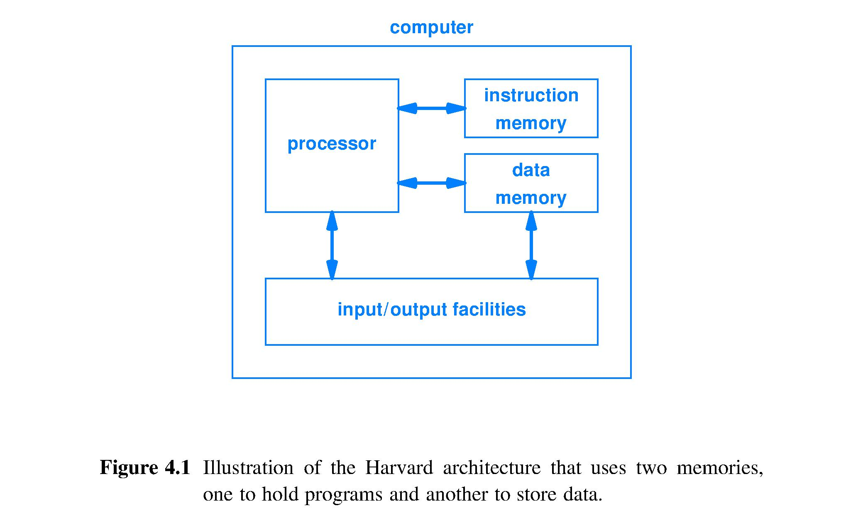
Harvard architecture
Idea by Howard Aiken, Harvard physicist, to IBM Nov. 1937
Built by IBM in Endicott, NY and delivered to Harvard in Feb. 1944 as the Mark 1 computer
Has separate memories for program (instructions) and data
Input/output (I/O) to connect to the world
Processor to carry out the computations

Slide 65
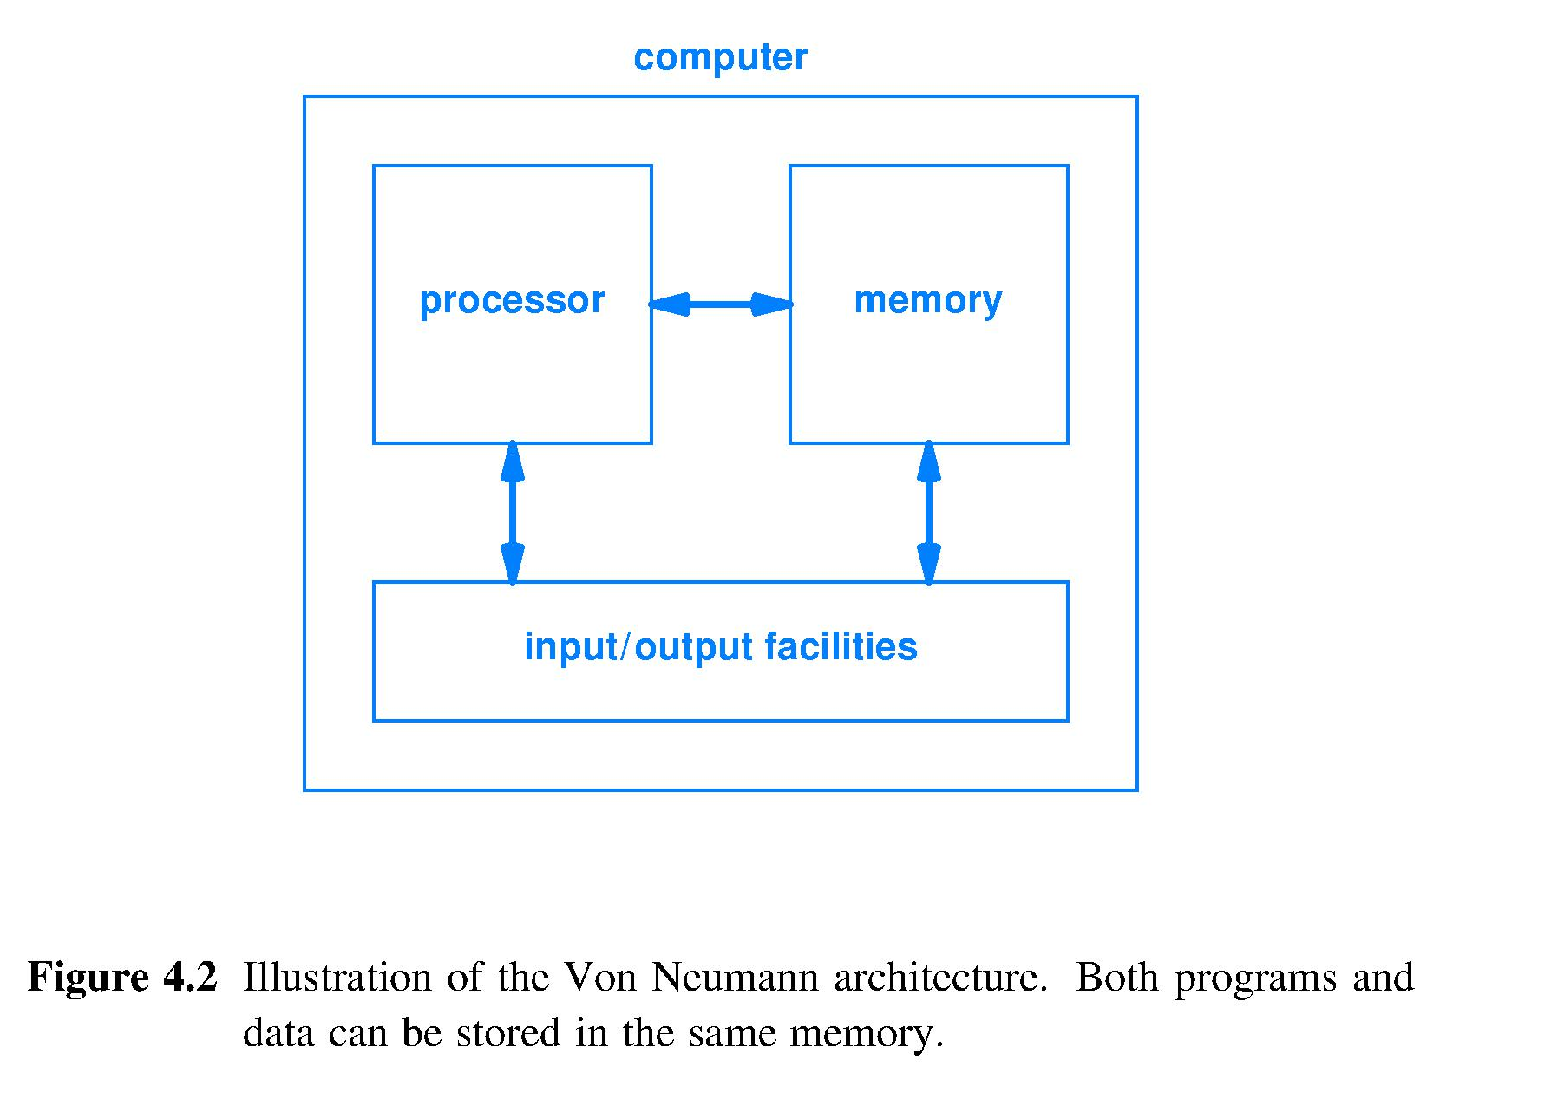
(John) Von Neumann architecture
Developed during his June 1945 train ride from Philadelphia to Los Alamos, NM
He had programmed Mark 1 in August 1944
One memory for both data and program
Same I/O, same processor as Aiken’s “Harvard” design
Notes:
Von Neumann clearly better at social media than Aiken (Harvard vs Von Neumann architectures)

Slide 66
Comparison of architectures
Harvard pro
Can optimize one memory for storing data, other for storing program
Can access data and program simultaneously
Harvard con
Less flexible, memory is physically partitioned
Von Neumann pro
Cheaper: each $ spent on memory helps store either data or program
Less secure: hardware cannot distinguish between program instructions and data values

Slide 67
Von Neumann bottleneck
Today, main memory technology (DRAM) is very slow compared to speed of a processor
Processors consume operands and produce results far faster than current main memory technology can readily source and sink them
Time spent accessing memory often dominates the total time to run a program
Architects use the term von Neumann Bottleneck to describe the situation when memory access time (processor waiting) is the majority of the run time

Slide 68
Operand addressing: immediate, direct, indirect
Operands can be found
Within an instruction: immediate
Within a register: direct (one HW pointing step using a register name (address) )
Within memory: direct memory (one HW pointing step using a memory address; rare today)
Within memory: indirect through a register (two pointing steps, first to register, then to memory; increasing the pointer size each step)
Within memory: indirect memory reference (today, would combine indirect through a register followed by another level of indirection using the contents of the first memory location as a subsequent address; may repeat indirection)

Slide 69
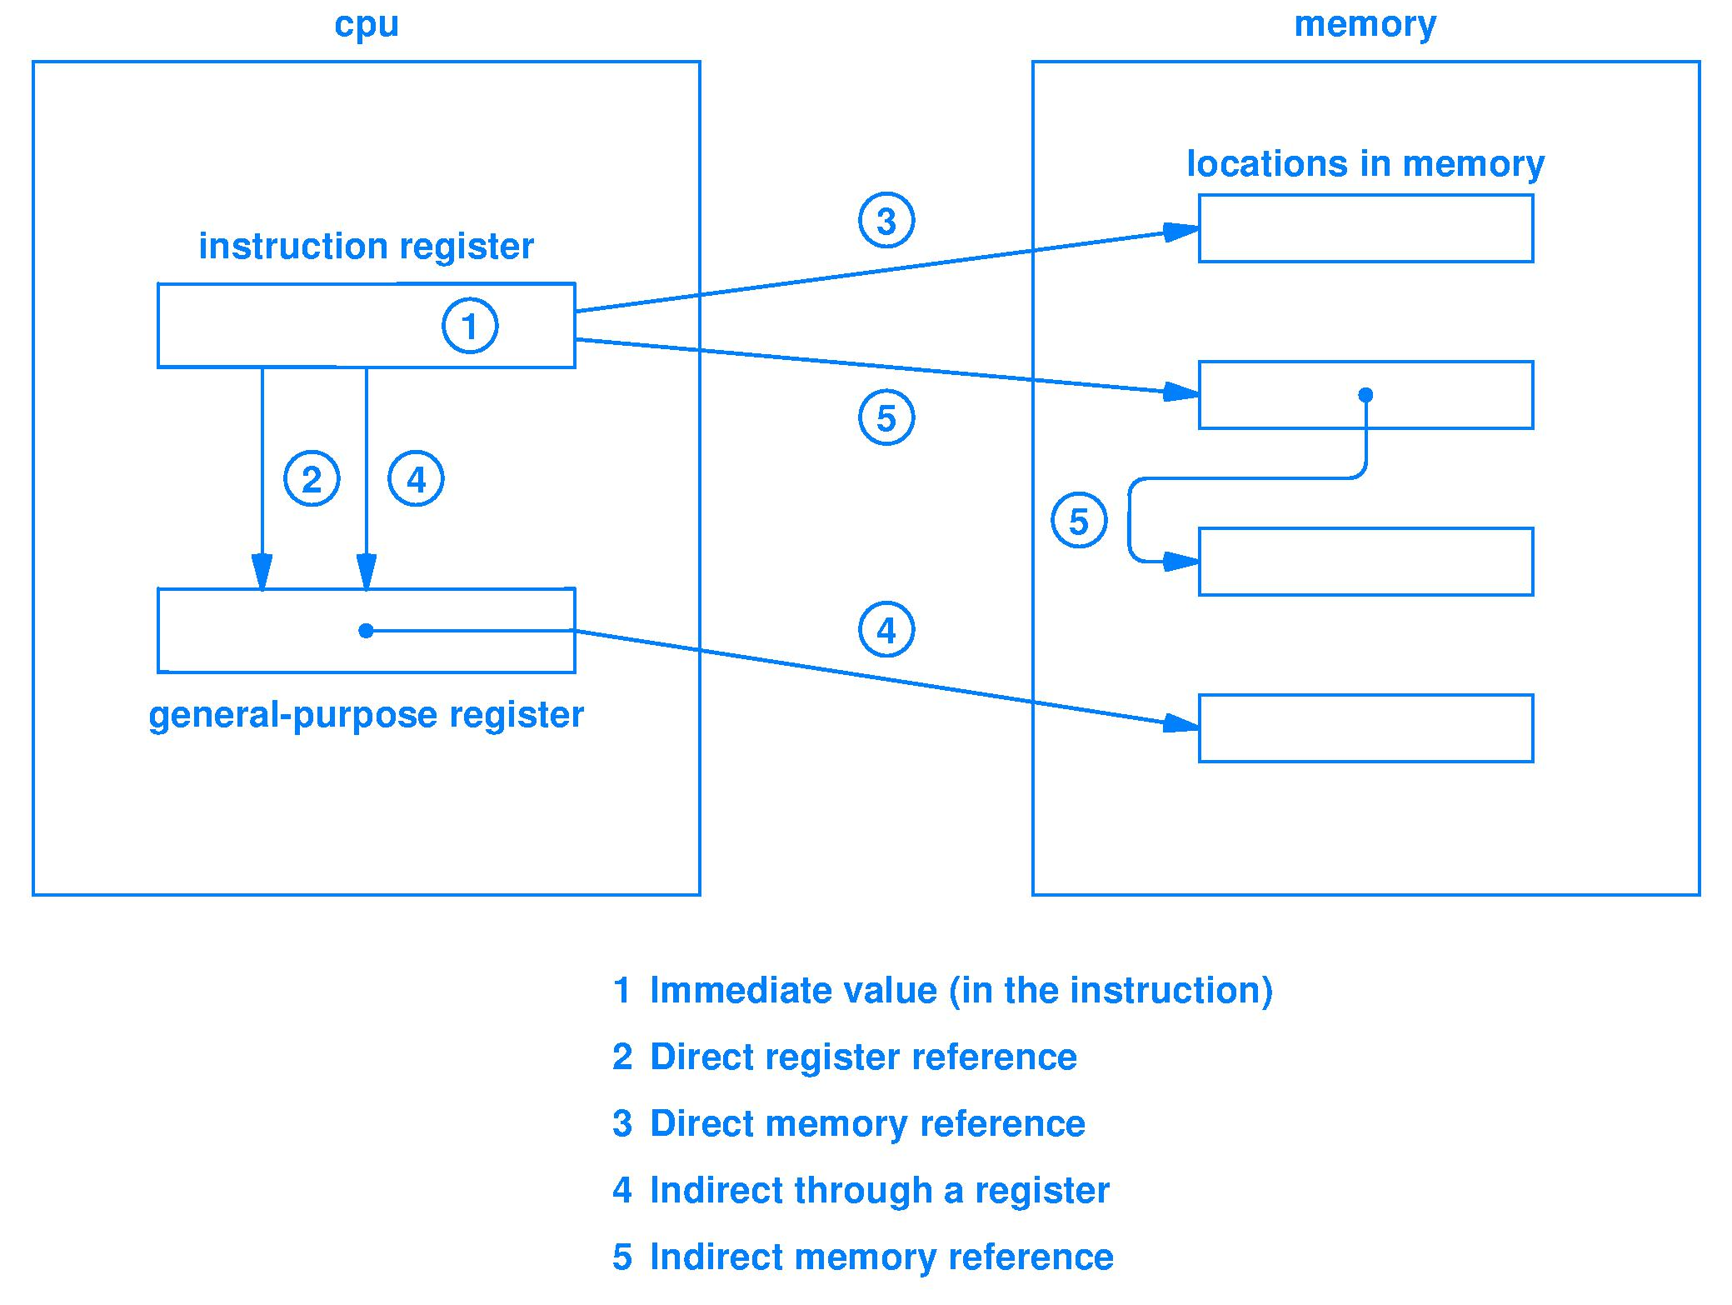
Example operand addressing modes (Fig. 7.6)
Notes:
Thought question

Slide 70
Design tradeoffs for operands
Different operand sources and forms have different
Ease of programming/compiling
Fewer/more machine instructions
Smaller/larger machine instructions
Larger/smaller range of immediate values
Faster/slower operand fetch
Larger/smaller processor circuit size
There is not one right answer

Slide 71
Summary
Operand types and addressing are design choices
Immediate operands are constants contained within the instruction
Pointers to registers (smaller) and memory (often too large) are used in instructions
Can obtain operands via indirection
Register contains an address to memory
A memory location contains an address to memory

